Slide 1
Digital Image Processing Final Project
主題： Seamless Refocusing
組別：13
組員：
林政均D11942011
林永平R10943016
潘彥伯R10942110

Slide 2
Agenda
Input format
SIFT & matching preprocess:
Gradient (Laplacian)
Sharpen
ROI set
Output
Demo

Slide 3
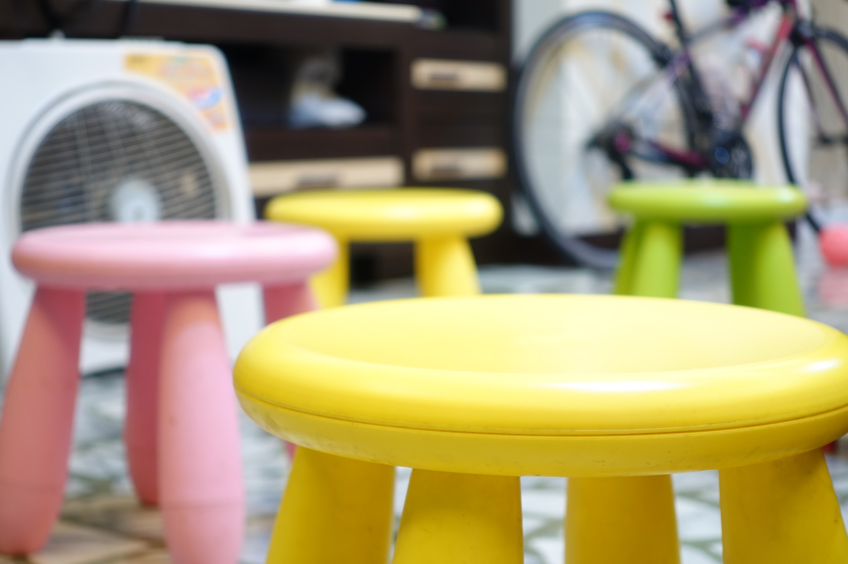
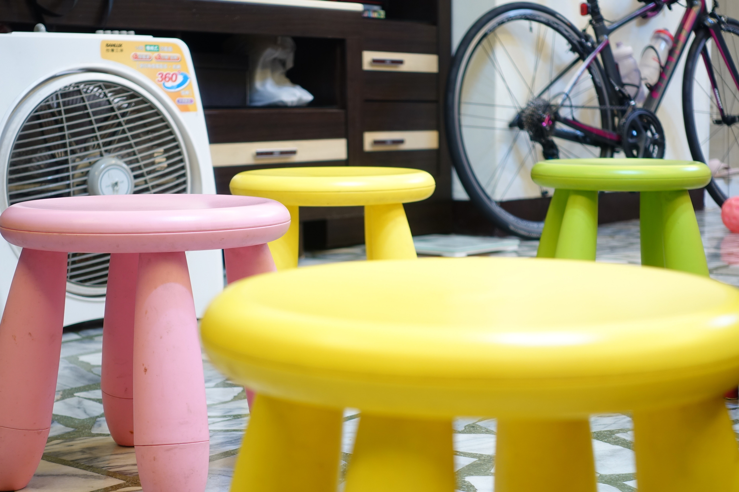

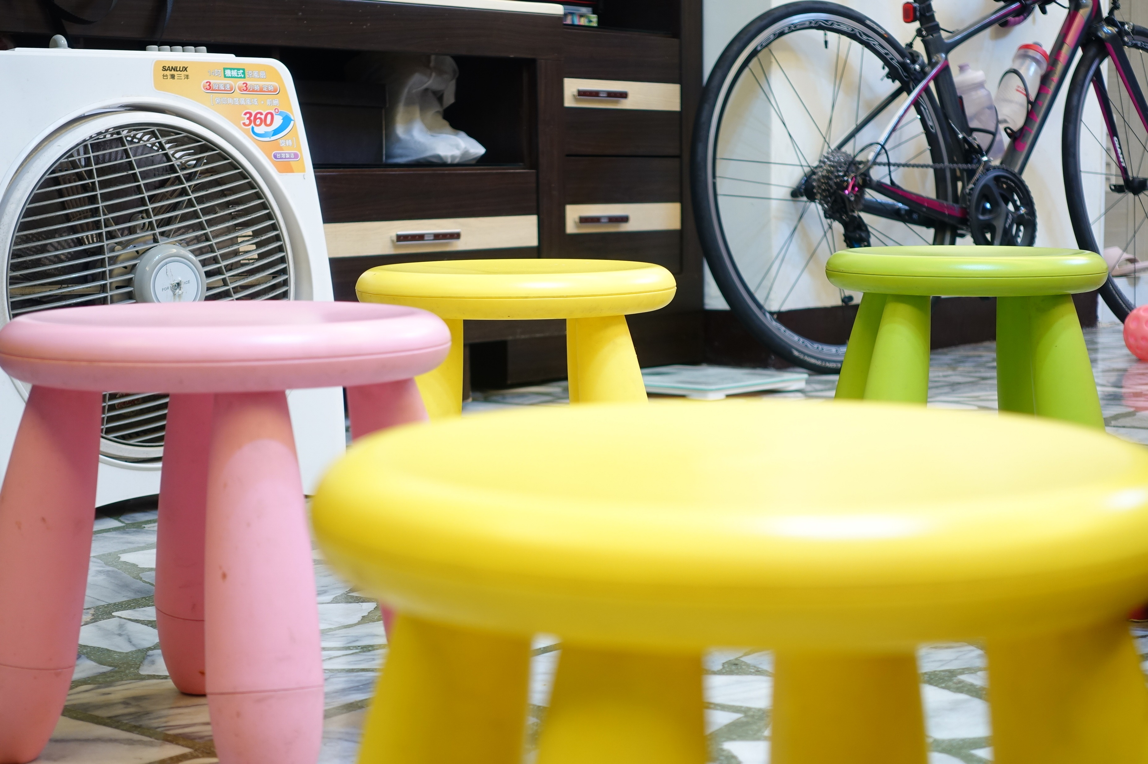

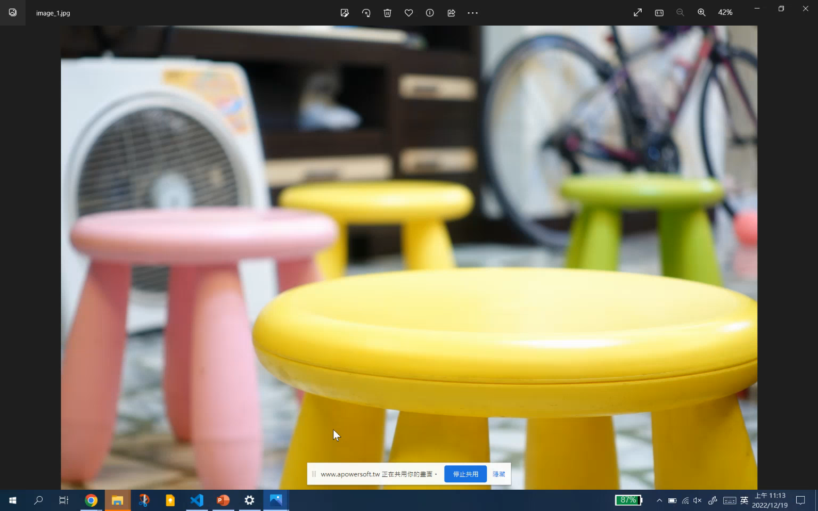
1. Input format
read all images of the path
input_1
input_2
input_3
input_4
input_5
choose
first
image
original input demo:
first image
Set the image to background
background

Slide 4

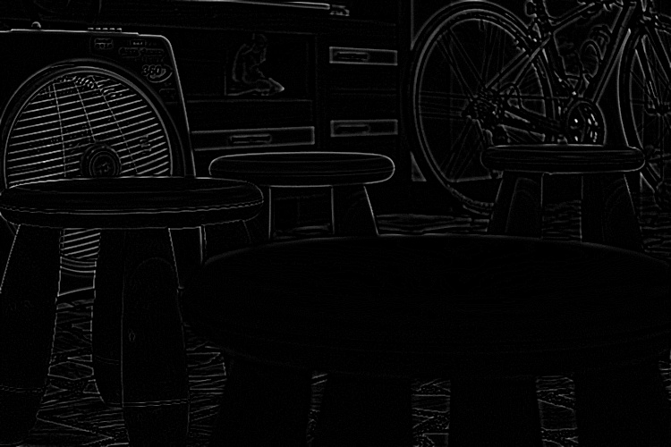
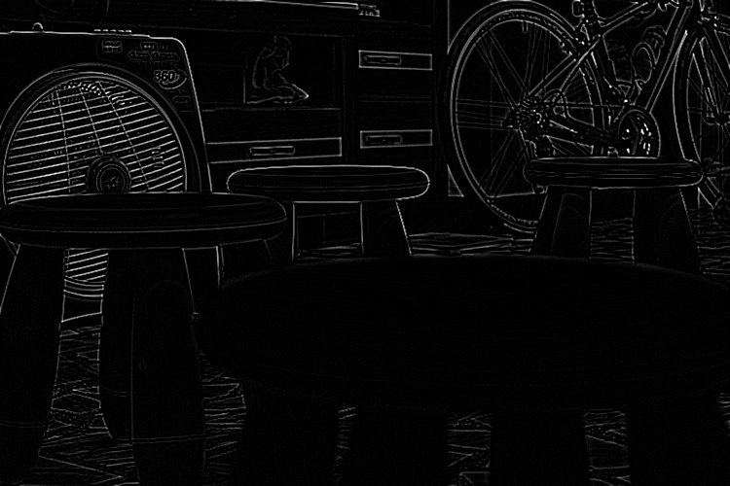
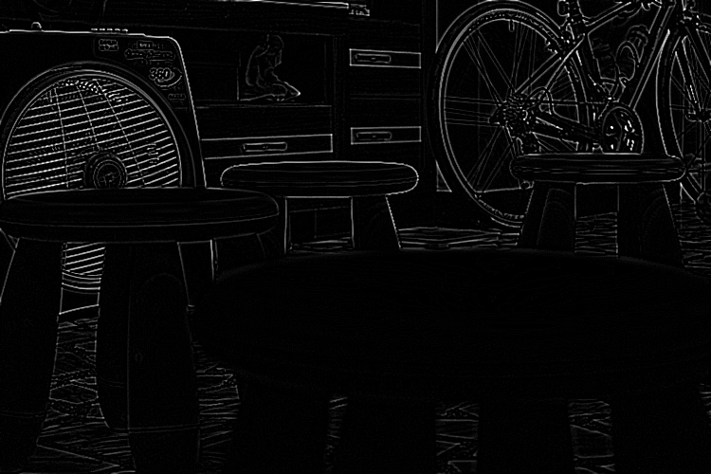
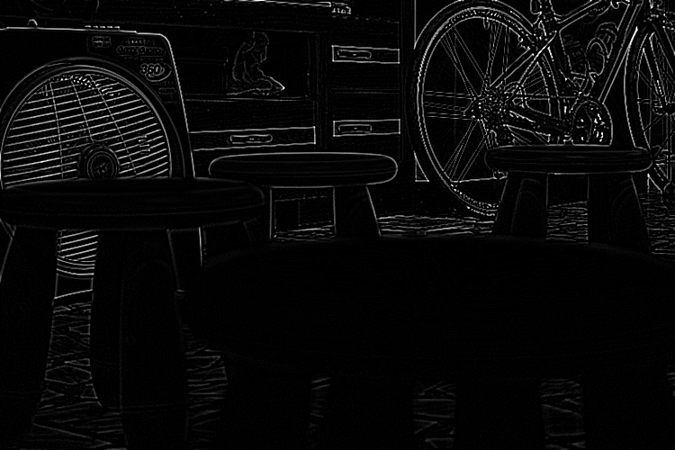
2-1. SIFT & matching preprocessing – Gradient(Laplacian)
Target: detect clear edge of images
Kernel:
Gradient processing flow:
Image→gray → GaussianBlur→Kernel Convolution →gradient result
1 | 1 | 1
1 | -8 | 1
1 | 1 | 1
gradient_result_1
gradient_result_2
gradient_result_3
gradient_result_4
gradient_result_5

Slide 5

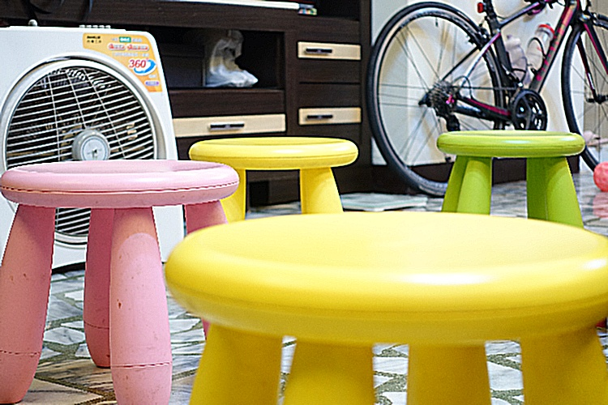



2-2. SIFT & matching preprocessing – Sharpen
Target: feature reinforcement
Kernel:
Gradient processing flow:
Image→GaussianBlur→Kernel Convolution → sharpen result
-1 | -1 | -1
-1 | 9 | -1
-1 | -1 | -1
sharpen_result_1
sharpen_result_2
sharpen_result_3
sharpen_result_4
sharpen_result_5

Slide 6

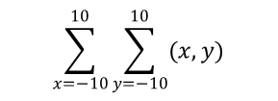
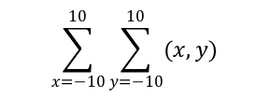
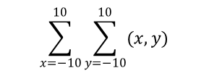
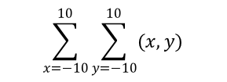
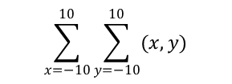
3. ROI set
$$\sum_{x=−10}^{10}{\sum_{y=−10}^{10}{(x,y)}}$$
sum1
Click point: (x,y)
ROI range: ((x,y)-10,(x,y)+10)
ROI processing flow:
Click specific point(x,y)
→ set ROI area((x,y)-10,(x,y)+10)
→ calculate correspond gradient intensity
→ choose max result
$$\sum_{x=−10}^{10}{\sum_{y=−10}^{10}{(x,y)}}$$
sum2
$$\sum_{x=−10}^{10}{\sum_{y=−10}^{10}{(x,y)}}$$
sum3
Result index
=max(sum1,
sum2,
sum3,
sum4,
sum5)
background
.
ROI
.
|←10→|←10→|
(x,y)
|←10→|←10→|
$$\sum_{x=−10}^{10}{\sum_{y=−10}^{10}{(x,y)}}$$
sum4
$$\sum_{x=−10}^{10}{\sum_{y=−10}^{10}{(x,y)}}$$
sum5

Slide 7
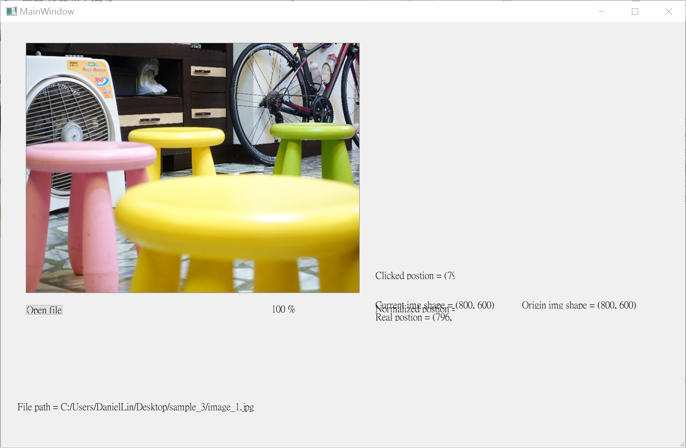
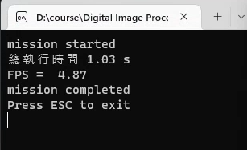
4. Output
dataset
input_1
input_2
input_3
input_4
input_5
Result index
Cut input_2
SIFT
Image registration
find min size and replace background
Image crop>
background
Image resize
Return to output window
Index correspond sharpen image
new background
camera difference:
Index=2
camera | type | Zoom in/out of far focal point
iPhone | cellphone | Zoom out
RX100M5 | camera | Zoom in
A6600+ sel1655G | MILC | unchanged
calculation time:
sharpen_result_2

Slide 8
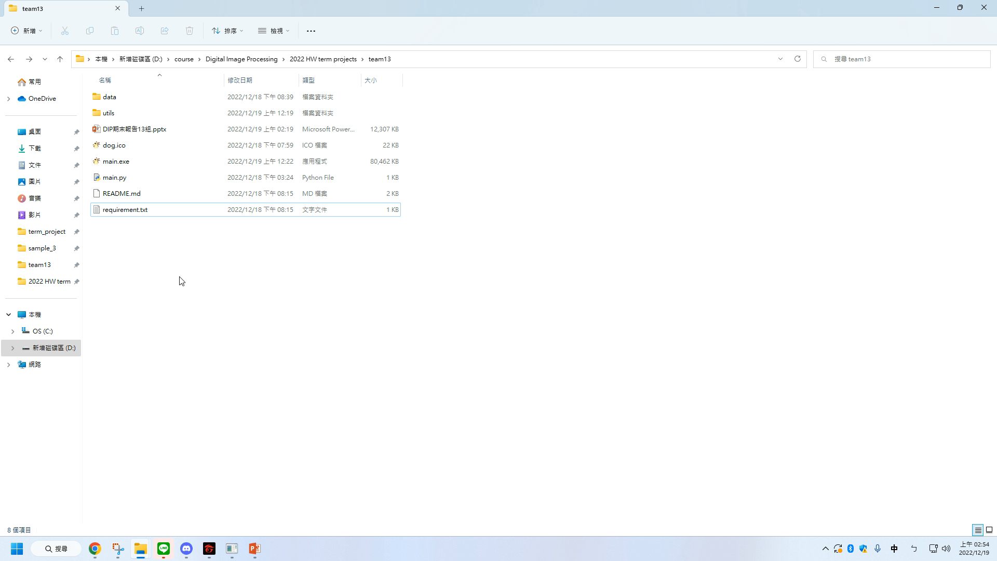
5. Demo

